Slide 1
Distributed Systems Service Oriented Computing

Slide 2
Goals
Understand the Foundations
Characterization
Programming models
Remote Invokation
Algorithms
Get knowledge on Middleware
Distributed Objects
Web Services
Test, Quality and Deployement
Code analysis
Docker

Slide 3
Content
Foundations
Platforms
Persistence
Distributed Object & Components
Service Computing

Slide 4
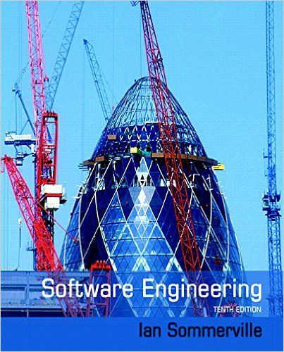
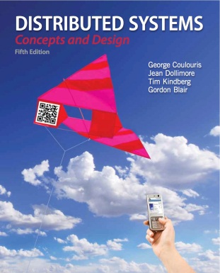
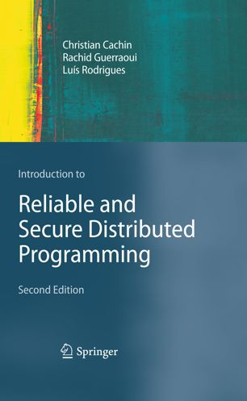
Bibliography
Distributed Systems 5th Edition
George Coulouris, Jean Dollimore, Tim Kindberg and Gordon Blair
http://www.cdk5.net/wp/
(Lot of illustration from this book)
Software Engineering 10
Ian Sommerville
Introduction to Reliable and Secure Distributed Programming
Christian Cachin, Rachid Guerraoui, Luís Rodrigues
Engineering Software Products
Ian Sommerville
Lecture of Martin Kleppman
https://www.cst.cam.ac.uk/teaching/2021/ConcDisSys

Slide 5
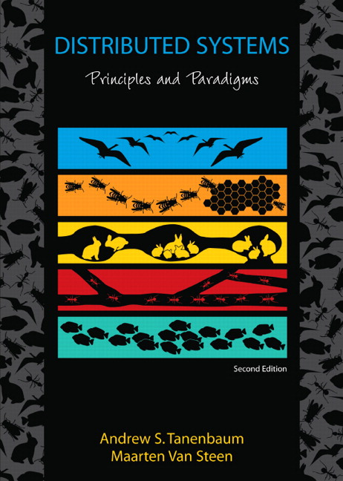
Distributed System
Definition
A collection of independent computers that appears to its users as a single coherent system [Tanenbaum and van Steen, 2007]
Independent, autonomous entities
Heterogeneity
“. . . a system in which the failure of a computer you didn’t even know existed can render your own computer unusable.” — Leslie Lamport

Slide 6
Why distribute ?
Inherent distribution
Information dissemination, cooperative systems, distributed storage, cooperative editors
Distribution as an artifact
For fault tolerance, load balancing, fast sharing
State machine replication
Solve bigger problems

Slide 7
Distributed Systems
Components communicate and coordinate their actions only by message passing.
Computer connected by a Network
Concurrency
No Global Clock
Independant Failure

Slide 8
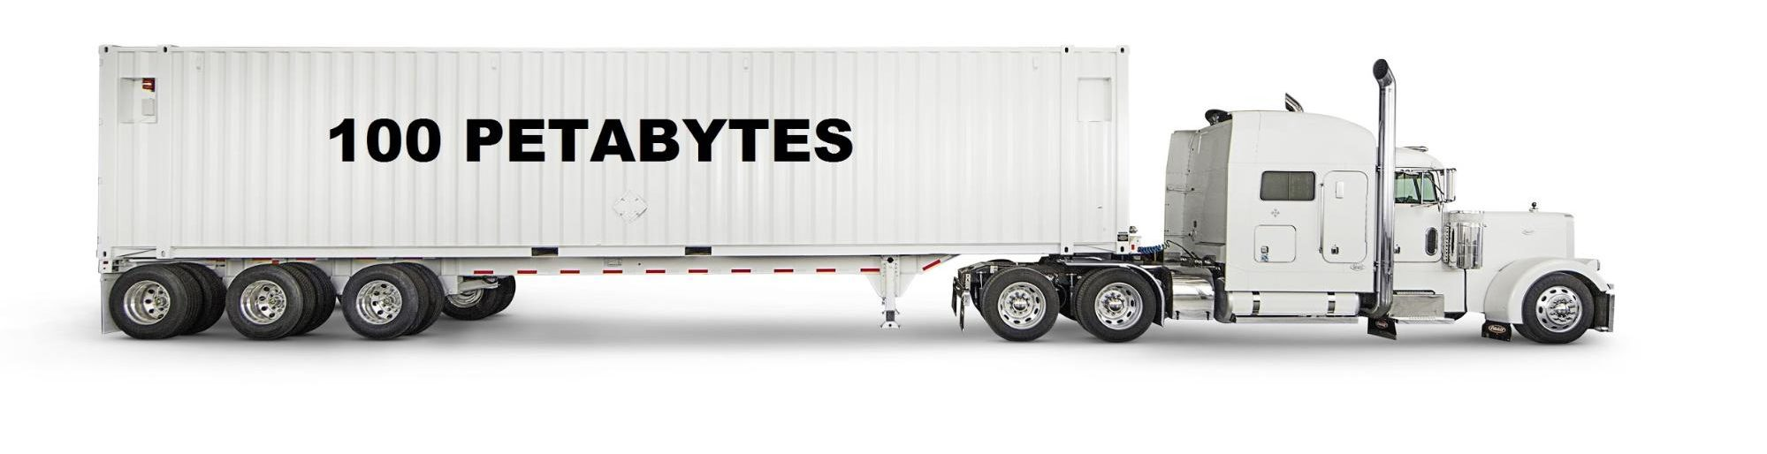
Latency and Bandwidth
Latency : time until a message arrives
In the same building : 1 ms
From a continent to another : 100 ms
Hard drive in a van : 1 day
Bandwidth : data volume per unit time
3G : 1 Mbit/s
Broadband : 100 Mb/s
Hard drive in van : 50 TB/b – 1Gbit/s (can be more)

Slide 9
Client Server Example

Slide 10
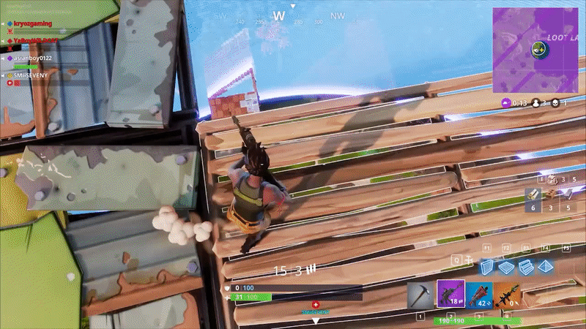
Examples of distributed systems
Web search
Massively multiplayers Online Games
Financial trading

Slide 11
Evolution of scales
Centralised computing
Distributed applications on a local network (LAN)
Distributed applications on a wide area network - Internet is the computer (Service, P2P)
Elastic / Utility Computing (Cloud, Grid)
Internet of things

Slide 12
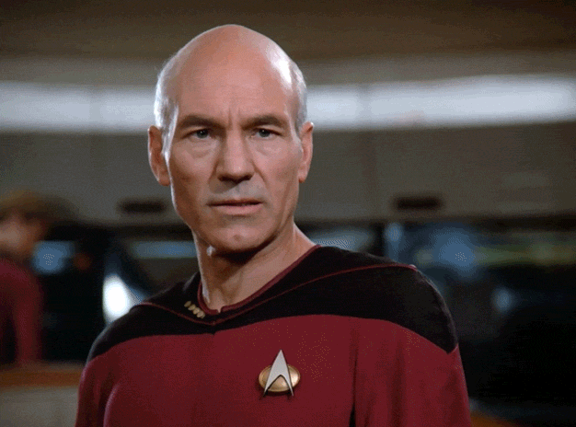
Challenges
Heterogeneity
Openness
Key interfaces are published
Security
Scalability
Failure Handling
Concurrency
Transparency
Quality of service

Slide 13
CAP Theorem
Consistency
Atomic data object
Availability
Every request to a data object results in a response
Partition Tolerance
The network can lose any number of messages
It is impossible to provide the three properties at the same time
Brewer's conjecture and the feasibility of consistent, available, partition-tolerant web services
Gilbert/Lynch
https://users.ece.cmu.edu/~adrian/731-sp04/readings/GL-cap.pdf

Slide 14
CAP revisited
Adapt the criteria to the applications
Adjust the consistency requirements from
Strong consistency to
Eventual consistency
Harvest, Yield, and Scalable Tolerant Systems (1999)
Armando Fox , Eric A. Brewer
https://citeseerx.ist.psu.edu/viewdoc/summary?doi=10.1.1.33.411

Slide 15
Eventual Consistency
Eventually Consistent
Werner Vogels – Décembre 2006
https://www.allthingsdistributed.com/2007/12/eventually_consistent.html
Discuss different kind of consistency
Causal consistency, read your writes consitency, Session consistency, Monotonic read consistency, Monotonic write consistency

Slide 16
Ordering of message

Slide 17
Distributed consensus algorithms
Generals plan a coordinated attack
They must all agree on attack (1) or retreat (0)
General communicate with foot messenger
Unreliable (can be lost or captured)
Connected communication graph

Slide 18
Impossibility theorem
We cannot make the difference between a slow host and a failed host

Slide 19
Development, operations and service computing
A Conversation between Jim Gray and Werner Vogels (2006)
https://queue.acm.org/detail.cfm?id=1142065

Slide 20
Failure Handling
Detecting failures
Masking failures
Tolerating failures
Recovery from failure
Redundancy

Slide 21
Scalability
Controling the cost of physical resources (O(n))
Controling the performance lost (O(log n))
Preventing software resources running out
Avoiding performance bottleneck
The Tail at Scale Jeffrey Dean, Luiz André Barroso
Communications of the ACM, vol. 56 (2013), pp. 74-80
https://research.google/pubs/pub40801/
Discuss techniques to maintain predictable latency even at a very large scale

Slide 22
Transparency (from the developer PoV)
Access transparency : local vs remote
Location transparency
Concurrency transparency
Replication transparency
Failure transparency
Mobility transparency
Performance transparency
Scaling transparency

Slide 23
Quality of service
Non functional properties
Reliability,
security,
performance,
Adaptability
Availability : from 99 to 99.99999

Slide 24
Writing code for distributed applications is extremely difficult without a framework

